Slide 1
ELBOW BIOMECHANICS
Dr Payal Dhawale
Dept. Of Sports Physiotherapy
MGM Institute Of Physiotherapy
Chh. Sambhajinagar

Slide 2
The joints & muscles of elbow complex serve an important role to provide mobility as well as stability function for the hand
Uniaxial diarthrodial joint of hinge type with 1 degree of freedom of motion

Slide 3
The elbow complex includes the elbow joint (humeroulnar and humeroradial joints) and the proximal and distal radioulnar joints elbow and forearm respectivily.

Slide 4
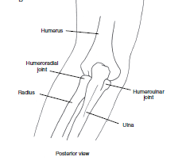
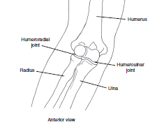
Bone

Slide 5
Articulating Surfaces –
Humeroulnar jt.
Concave trochlear notch of ulna
Convex trochlea of humerus
Humeroradial jt.
Conave Fovea of head of radius
Convex Spherically shaped capitulum

Slide 6
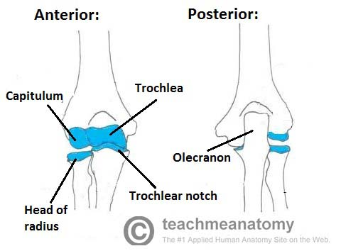

Slide 7
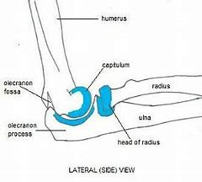

Slide 8
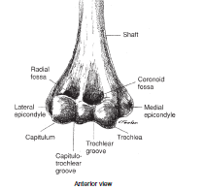
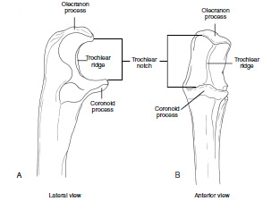
Lateral and anterior veiw
A

Slide 9
Joint capsule
The Capsule is large ,loose and weak
anteriorly but ligaments reinforce from its sides
Attachments - anterior, posterior, medial, lateral

Slide 10
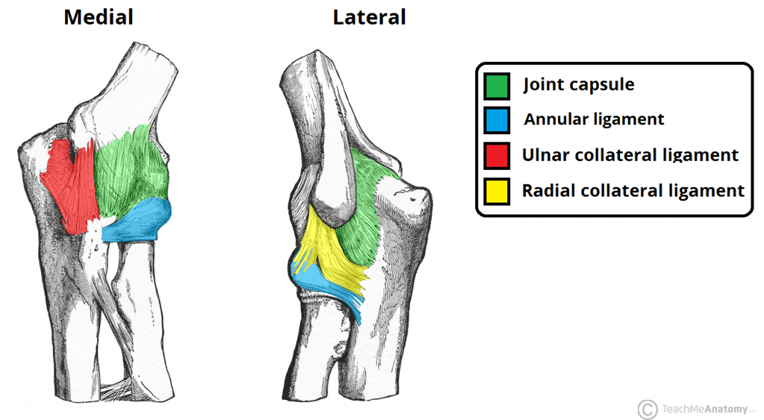
Ligaments :
2 main ligaments –
Medial Collateral Ligament
Lateral collateral Ligament

Slide 11
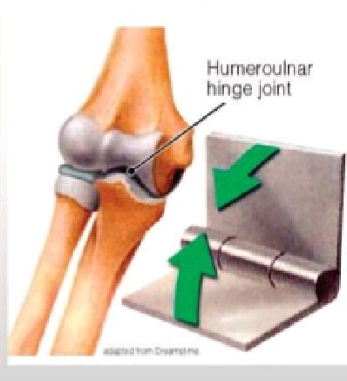
The elbow joint is considered to be a compound joint that functions as a modified or loose hinge joint.

Slide 12
One degree of freedom is possible at the elbow, permitting the motions of flexion and extension,
which occur in the sagittal plane around a coronal axis.

Slide 13
A slight bit of axial rotation and side-to-side motion of the ulna occurs during flexion and extension, and that is why the elbow is considered to be a modified or loose hinge joint rather than a pure hinge joint.

Slide 14
Two major ligaments and five muscles are directly associated with the elbow joint.
Three of the muscles are flexors that cross the anterior aspect of the joint.
The other two muscles are extensors that cross the posterior aspect of the joint.

Slide 15
Extension – triceps brachii and anconeus
Flexion – brachialis, biceps brachii, brachioradialis

Slide 16

Ligaments
Medial Collateral Ligament
3 parts –
Anterior
Posterior
Transverse/Oblique

Slide 17
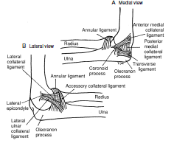

Slide 18
Anterior Fibers :strongest
& stiffest
Arise from anterior aspect of medial epicondyle & insert on medial part of coronoid process of ulna
Consists of 3 anatomically & functionally distinct fibers based on proximal attachment

Slide 19
Fibers arising from anterior surface of medial condyle – taut in full extension
Fibers arising from below tip of medial epicondyle – taut in 90° flexion to full flexion
Fibers arising from inferior edge of medial epicondyle – always taut throughout full ROM

Slide 20
Anterior portion of the MCL is considered to be the primary stabilizer of the elbow to valgus stress in the range of elbow flexion from 20-120 deg of flexion
Primary restraint to valgus at 30°, 60°, and 90°of flexion
Coprimary restraint to valgus at 120° of flexion

Slide 21
Posterior Fibers :
Attachment –
Originate - Posterior part of medial
epicondyle
Insert - Medial margin of olecranon &
coronoid process
Primary restraint to valgus at 120° of flex & secondary restraint at 30° & 90° of flexion
Function –
Becomes taut in extremes of elbow flexion & so limits extension
Prevents posterior translation of radial head

Slide 22
Transverse Fibers :
Cross from olecranon to coronoid process of ulna
Since they originate & insert on same bone , they don’t provide significant articular stability

Slide 23
Lateral Collateral ligamentous complex :
Lateral Radial Collateral Ligament
Lateral Ulnar Collateral Ligament
Annular Collateral Ligament
Originates on lateral epicondyle & immediately splits into 2 fiber bundles

Slide 24
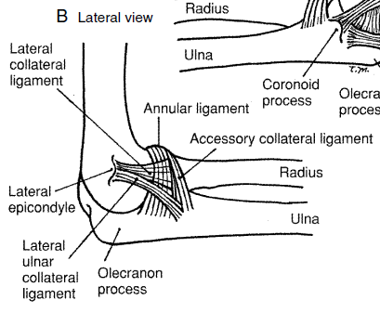
Fan shaped
That extend from inf aspect lateral epicondyle of the humerous to merge with the annular ligament

Slide 25
FIBER STABILIZATION
MCL
All fibers stabilize against the valgus stress at elbow
LCL
All fibers stabilize against the varus stress at elbow

Slide 26
Kinematics
One degree of freedom
  Flexion: 135 to145°
  Passive flexion: 150 to 160
  Extension: -5° (hyperextension)
  Functional Range: 30-130°

Slide 27
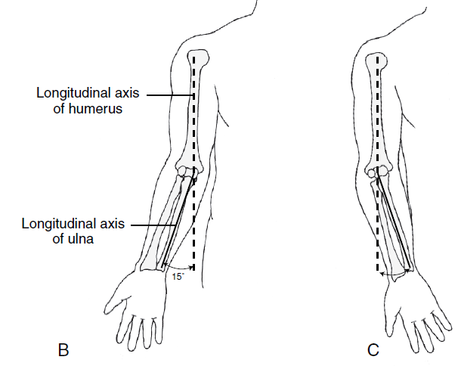
Carrying angle
Males – 0-5 deg
Females - 10-15 deg
Cubitus valgus/varus

Slide 28
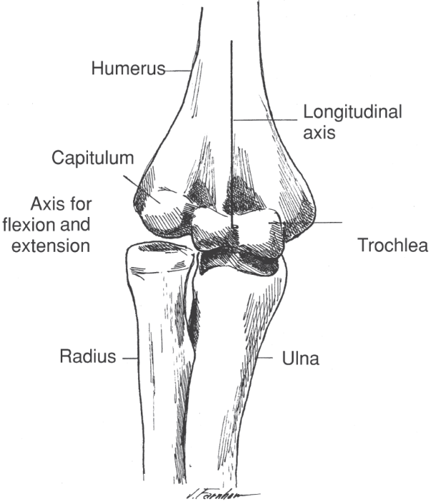
Axis of motion
Axis of motion
Axis for flexion & extension is relatively fixed & passes through the centre of trochlea & capitulum bisecting the longitudnal axis of shaft of humerus

Slide 29
Arthrokinematics
At Humeroulnar jt
Flexion –
Concave surface of trochlear notch rolls & slides anteriorly on convex trochlea
Full pasive elbow flexion requires elongation of the Posterior capsule, extensor ms, ulnar nerve, post fibres of MCL
Extension - vice versa

Slide 30
Arthrokinematics
At Humeroradial jt
There is rolling & sliding of fovea of radius across convexity of capitulum
Provides minimal structural stability to elbow jt ,however, provides an imp bony resistance against a valgus force

Slide 31
Elbow Muscles

Slide 32
Functions of elbow muscles :
Elbow flexors
Role of elbow flexors is determined by number of factors –
Location of muscles
Position of elbow & adjacent joints
Position of forearm
Magnitude of applied load
Speed of motion
Type of muscle contraction

Slide 33
Brachialis
Mobility ms – insertion close to jt axis
Average physiologic cross-section of 7 cm2 ,the largest of any ms crossing the elbow – generates the greatest force of any ms crossing the elbow, so active in all types of contraction

Slide 34
Work horse of elbow flexion as it is active in all positions ,all speeds & against maximal /minimal resistance
MA is greatest at slightly > 100 of elbow flexion
Not affected by change in position of forearm / shoulder, so active in all positions

Slide 35
Biceps Brachii
Mobility ms – insertion close to jt axis
MA is largest between 80 -100⁰ of elbow flexion
In full elbow extension msl force is compressive
Beyond 100 flexion , acts as a distracting force
Affected by change in position of shoulder & elbow

Slide 36
Brachioradialis
Inserted away from jt axis-stability ms
Peak MA occurs between 100- 120 of elbow flexion
More active in midprone position
Not affected by change in position of forearm/shoulder

Slide 37
Maximal torque produced by elbow flexors : depends on 2 factors –
Muscles maximal flexion force potential eg. Brachialis
Internal moment arm length eg. elbow flexion with forearm in supination

Slide 38
Elbow extensors
Triceps Brachii
Anconeus
Anconeus usually 1st to initiate & maintain low level extension forces
Next , medial head of triceps followed by lateral head & long head of triceps
Medial head – work horse of extensors
Long head – Reserve elbow extensor

Slide 39
Effectiveness of triceps is affected by change in position of shoulder but not by changes in position of forearm
Maximal isometric torque is generated at elbow 90 flexed

Slide 40
Effectiveness of triceps is affected by change in position of shoulder but not by changes in position of forearm
Maximal isometric torque is generated at elbow 90 flexed

Slide 41
Radioulnar joints
The radioulnar joints are two locations in which the radius and ulna articulate in the forearm:
Proximal radioulnar joint
Distal radioulnar joint

Slide 42
Proximal radioulnar joint: This is located near the elbow, and is an articulation between the head of the radius, and the radial notch of the ulna.

Slide 43
Distal radioulnar joint: This is located near the wrist , and is an articulation between the ulnar notch of the radius, and the ulnar head.

Slide 44
Both of these joints are classified as pivot joints, responsible for pronation and supination of the forearm.

Slide 45
Proximal radioulnar joint :
Articulating surfaces –
- Concave radial notch
- Head of radius
- Annular ligament
- Capitulum of humerus

Slide 46
Distal Radioulnar joint :
Articulating surfaces –
- Ulnar notch of radius
- Head of ulna
- Articular disk

